Slide 1
GTPL BANK GURU99 DEMO SITE
PRESENT BY :-GAURAV PATIL

Slide 2
INTRODUCTION
The GTPL Demo Guru99 Bank project aims to provide net banking facility to its Users.
IN this project live site is provide to users to Execute the test scenario and case.
This release will have limited features. Over a period of time , new and new functionalities will be added to the site.

Slide 3
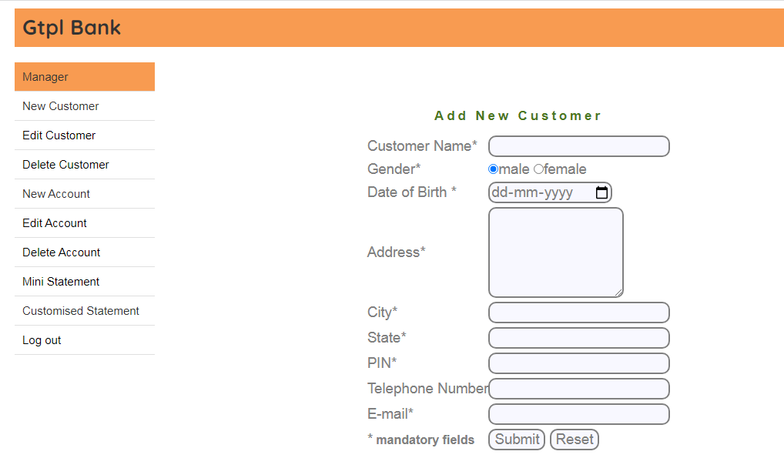
New Customer

Slide 4
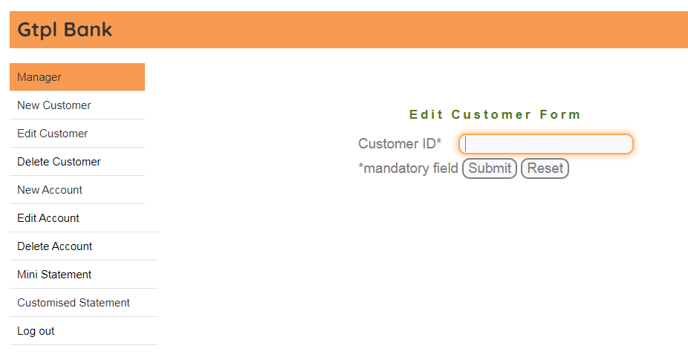
Edit Customer

Slide 5
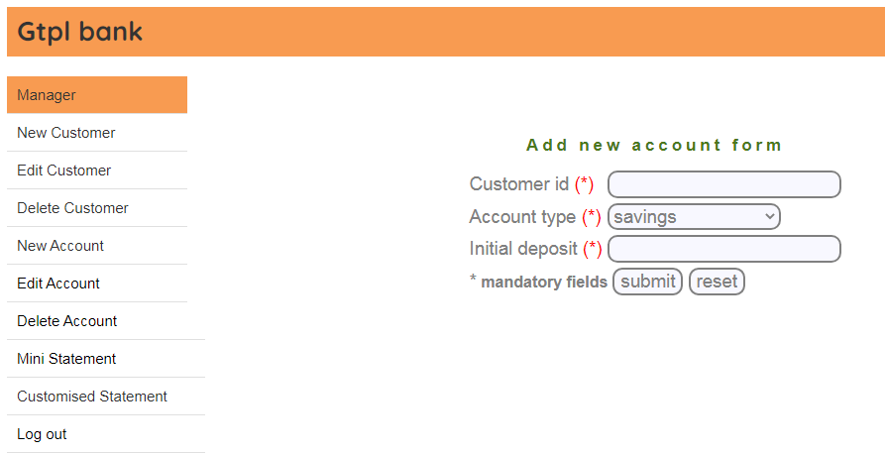
New Account

Slide 6
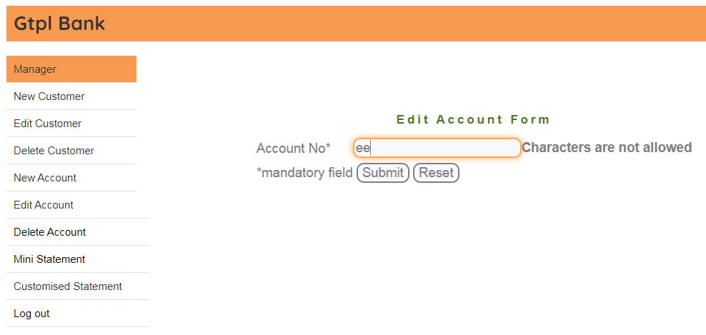
Edit Account

Slide 7
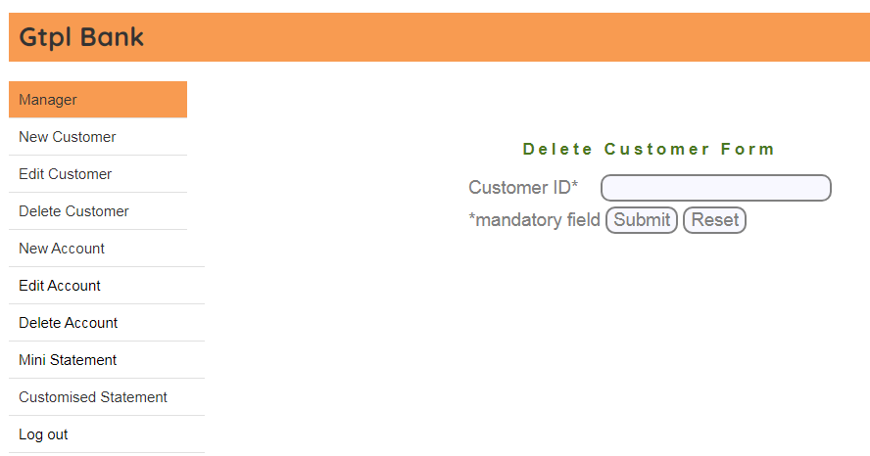
Delete Customer

Slide 8
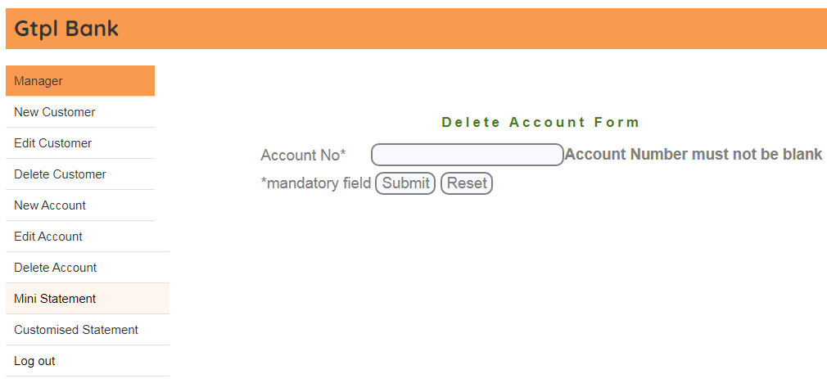
Delete Account

Slide 9

Mini Statement

Slide 10
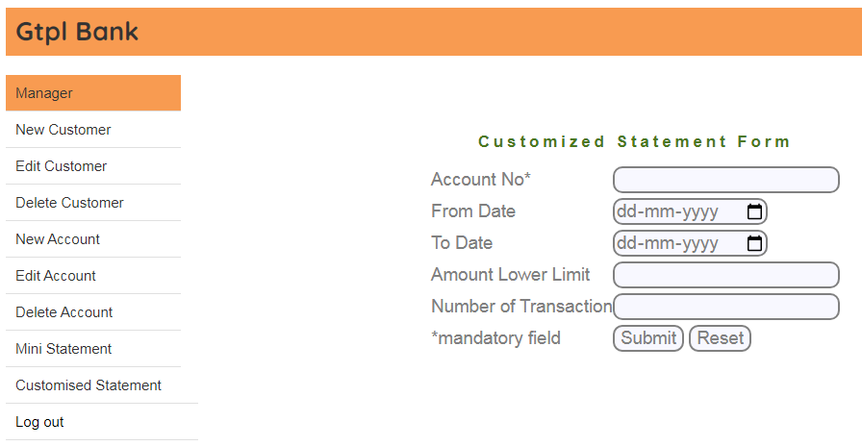
Customized Statement

Slide 11
Thank You

